Slide 1

Machine Vision
Wu Wei

Slide 2
Images Enhancement
01
02
03
04
05
Gray Level Transformations
Histogram Processing
Arithmetic/Logical Operation
Spatial Filtering
Frequency Filtering

Slide 3
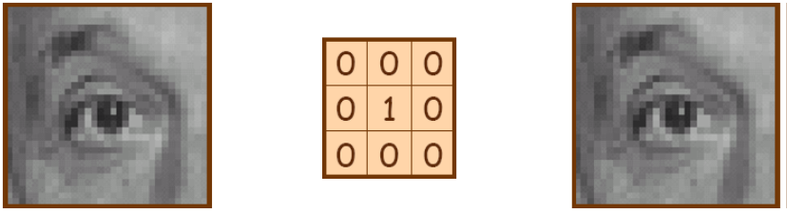
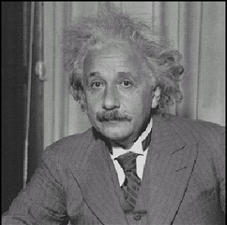
Spatial Filtering
Smoothing
Original
Filtered (no change)

Slide 4
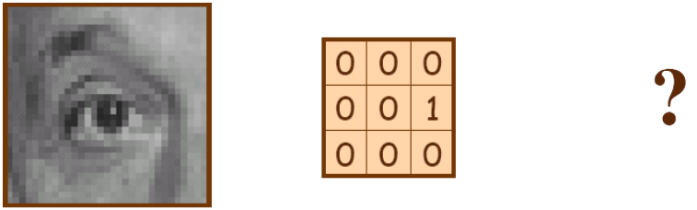
Spatial Filtering
Smoothing
Original

Slide 5
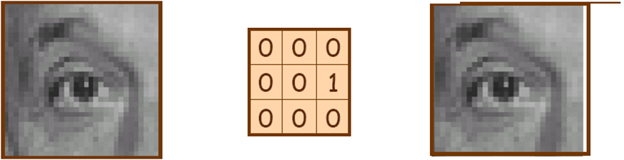
Spatial Filtering
Smoothing
Original
Shifted left By 1 pixel

Slide 6

Spatial Filtering
Smoothing
Original

Slide 7
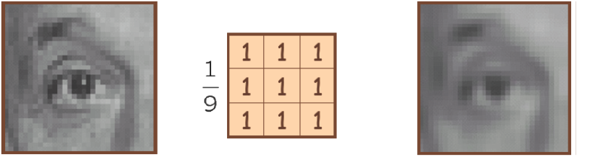
Spatial Filtering
Smoothing
Original
Blur (with a box filter)

Slide 8

Spatial Filtering
Smoothing
(Note that filter sums to 1)
Original

Slide 9
Spatial Filtering
Fundamentals (Kernel, convolution, filtering)
Smoothing (Linear / non-linear filters)
Sharpening (The Laplacian-2ndorder derivatives, the gradient -first order derivatives)
Combing Spatial Enhancement Methods

Slide 10
Spatial Filtering
Sharpening
Principle objective
To highlight fine detail in an image or to enhance detail that has been blurred, either in error or as a natural effect of a particular method of image acquisition.

Slide 11
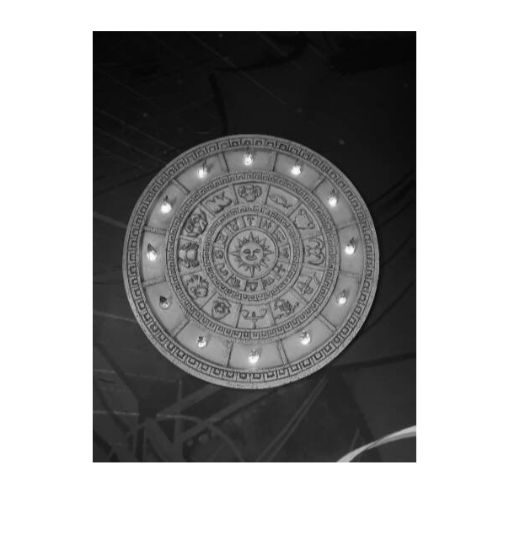
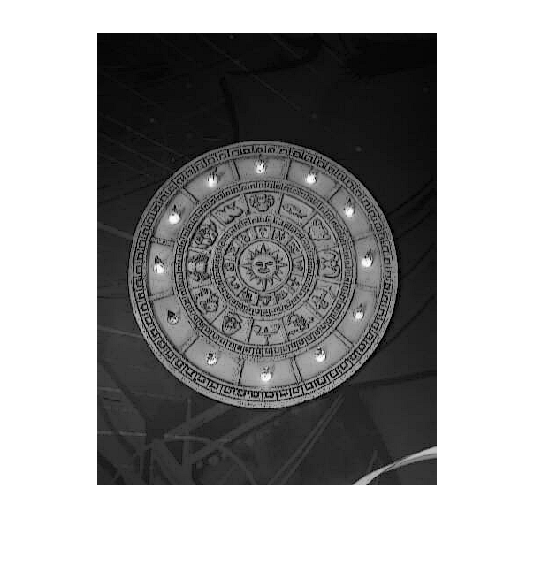
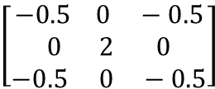
Spatial Filtering
Sharpening
Previously we have looked at smoothing filters which remove fine detail
Sharpening spatial filters seek to highlight fine detail
- Remove blurring from images
- Highlight edges
Sharpening filters are based on spatial differentiation
$$\left[\begin{aligned}−0.5 0 −0.5 \\ 0 2 0 \\ −0.5 0 −0.5\end{aligned}\right]$$
Image
Sharpened image

Slide 12
Spatial Filtering
Sharpening
Properties of 1st and 2nd-Order Derivatives
Use of 2nd Derivatives for Enhancement- The Laplacian
Use of 1st Derivatives for Enhancement - The Gradient

Slide 13
Spatial Filtering
Sharpening
First order derivative for a discrete function
Second order derivative for a discrete function

Slide 14
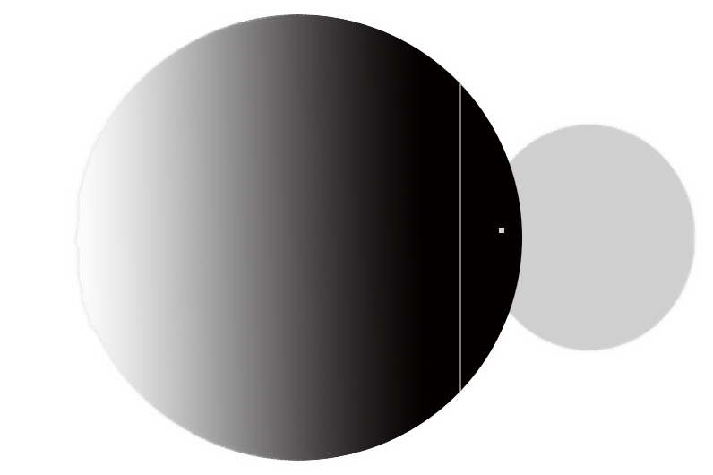
Spatial Filtering
Sharpening
Gray level profile
Image strip
8 | 8 | 8 | 7 | 6 | 5 | 4 | 3 | 2 | 1 | 0 | 0 | 0 | 1 | 4 | 1 | 0 | 0 | 0 | 9 | 0 | 0 | 5 | 5
 | 0 | 0 | -1 | -1 | -1 | -1 | -1 | -1 | -1 | -1 | 0 | 0 | 1 | 3 | -3 | -1 | 0 | 0 | 9 | -9 | 0 | 5 | 0
 | 0 | -1 | 0 | 0 | 0 | 0 | 0 | 0 | 0 | 1 | 0 | 1 | 2 | -6 | 2 | 1 | 0 | 9 | -18 | 9 | 5 | -5
First Derivative
Second Derivative

Slide 15
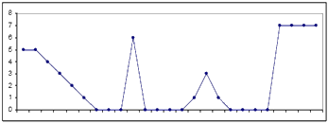
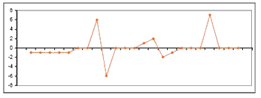
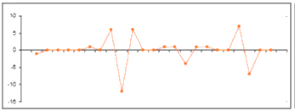
Spatial Filtering
Sharpening
Definition:
First derivative filter output
Zero at constant intensities
Non zero at the onset of a step or ramp
Non zero along ramps
Second derivative filter output
Zero at constant intensities
Non zero at the onset of a step or ramp
Zero along ramps
First derivative filter output
Second derivative filter output

Slide 16
Spatial Filtering
Sharpening
Conclusion:
First-order derivatives generally produce thicker edges in an image.
Second-order derivatives have a stronger response to fine detail, such as thin lines and isolated points.
First order derivatives generally have a stronger response to a gray-level step.
Second-order derivatives produce a double response at step changes in gray level.

Slide 17
Spatial Filtering
Sharpening
Properties of 1st and 2nd-Order Derivatives
Use of 2nd Derivatives for Enhancement- The Laplacian
Use of 1st Derivatives for Enhancement - The Gradient

Slide 18
Spatial Filtering
Sharpening
A common second derivative sharpening filter is the Laplacian
– Isotropic
• Rotation invariant: Rotating the image and applying the filter is the same as applying the filter and then rotating the image.
– One of the simplest sharpening filters

Slide 19
Spatial Filtering
Sharpening
The Laplacian

Slide 20
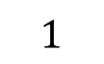

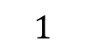
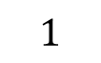
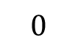
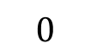
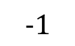
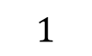
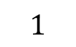
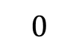
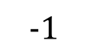
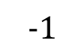
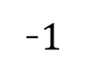
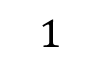
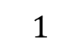
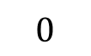
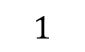
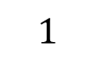
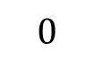
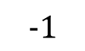
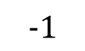
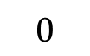
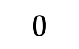
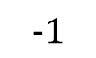
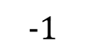
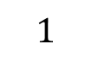
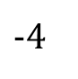
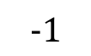
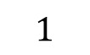
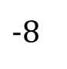
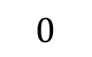
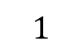
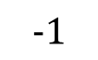
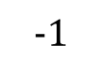
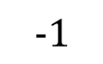
Spatial Filtering
Sharpening
The Laplacian
$$0$$
$$1$$
$$0$$
$$1$$
$$1$$
$$1$$
$$0$$
$$−1$$
$$0$$
$$−1$$
$$−1$$
$$−1$$
$$1$$
$−$4
$$1$$
$$1$$
$−$8
$$1$$
$$−1$$
4
$$−1$$
$$−1$$
8
$$−1$$
$$0$$
$$1$$
$$0$$
$$1$$
$$1$$
$$1$$
$$0$$
$$−1$$
$$0$$
$$−1$$
-$1$
$$−1$$

Slide 21
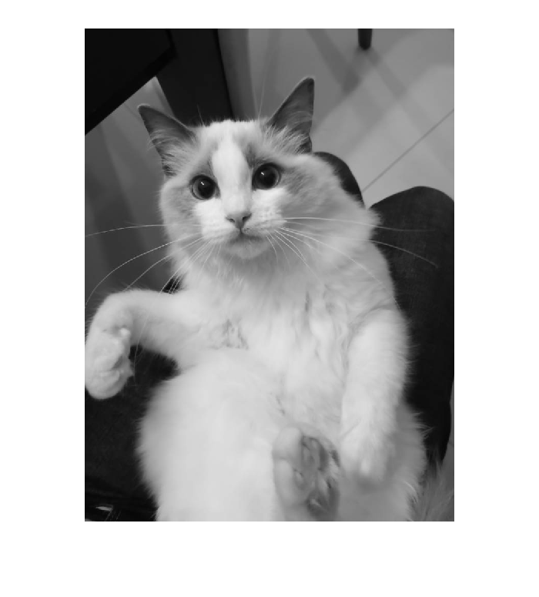
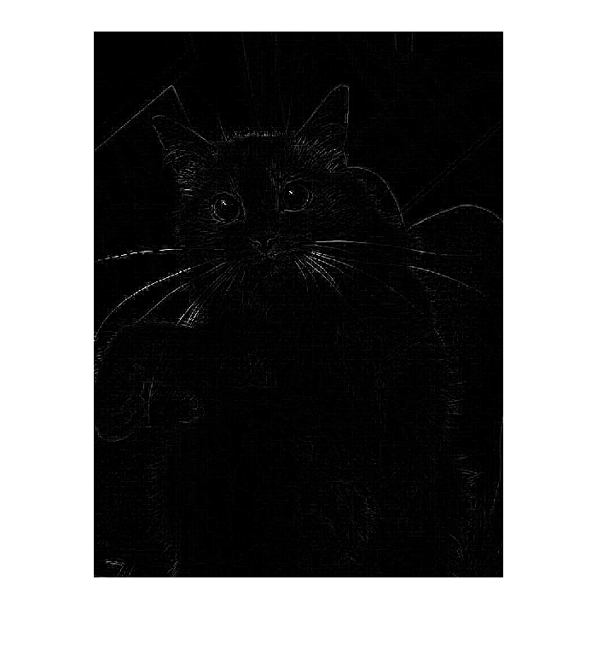
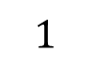
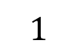







$$1$$
$$2$$
$$1$$
Spatial Filtering
$$1$$
$−$10
$$1$$
Sharpening
$$1$$
$$2$$
$$1$$
The Laplacian
Original Image
Laplacian Filtered Image

Slide 22
Spatial Filtering
Sharpening
The Laplacian
The result of a Laplacian filtering is not an enhanced image
We have to do more work
Subtract the Laplacian result from the original image to Laplacian Filtered Image generate our final sharpened enhanced image

Slide 23



Spatial Filtering
Sharpening
The Laplacian
-
=
In the final, sharpened image, edges and fine detail are much more obvious

Slide 24

Spatial Filtering
Sharpening
The Laplacian
Original Image
Enhanced Image

Slide 25
Spatial Filtering
Sharpening
The Laplacian
Original Image
Enhanced Image

Slide 26

















$$0$$
$$1$$
$$0$$
$$1$$
$$1$$
$$1$$
$$1$$
$−$4
$$1$$
$$1$$
$−$8
$$1$$
Spatial Filtering
$$0$$
$$1$$
$$0$$
$$1$$
$$1$$
$$1$$
Sharpening
$$0$$
$$−1$$
$$0$$
$$−1$$
$$−1$$
$$−1$$
The Laplacian
$$−1$$
4
$$−1$$
$$−1$$
8
$$−1$$
$$0$$
$$−1$$
$$0$$
$$−1$$
-$1$
$$−1$$
The composed Laplacian enhancement image is given by:
if the center coefficient of the Laplacian mask is negative
if the center coefficient of the Laplacian mask is positive

Slide 27

Spatial Filtering
Sharpening
The Laplacian
The entire enhancement can be combined into a single filtering operation:

Slide 28



Spatial Filtering
Sharpening
The Laplacian
This gives us a new filter which does the whole job in one step

Slide 29


Spatial Filtering
Sharpening
The Laplacian
There are lots of slightly different versions of the Laplacian that can be used:

Slide 30

Spatial Filtering
Sharpening
The Laplacian
(Note that filter sums to 1)
Original
Sharpening filter
- Accentuates differences with local average

Slide 31

Spatial Filtering
Sharpening
The Laplacian
Before
After

Slide 32
Spatial Filtering
Sharpening
The Laplacian
Unsharp Masking and High-Boost Filtering
Unsharp masking is expressed as
where is a blurred version of f(x, y)
high-boost filtering ---- a slight further generalization of unsharp masking

Slide 33
Spatial Filtering
Sharpening
Properties of 1st and 2nd-Order Derivatives
Use of 2nd Derivatives for Enhancement- The Laplacian
Use of 1st Derivatives for Enhancement - The Gradient

Slide 34
Spatial Filtering
Sharpening
The Gradient -Use of 1st Derivatives for Enhancement
They are implemented using the magnitude of the gradient
–Gradient definition
–The magnitude of the Gradient
– For computational consideration, in practice
Notes:
，

Slide 35






Spatial Filtering
Sharpening
The Gradient
The gradient points in the direction of most rapid increase in intensity.
$$∇f=\left[\frac{∂f}{∂x}, 0\right]$$
$$∇f=\left[0, \frac{∂f}{∂y}\right]$$
$$∇f=\left[\frac{∂f}{∂x},\frac{∂f}{∂y}\right]$$

Slide 36


Spatial Filtering
Sharpening
The Gradient
Which shows changes with respect to x?
Original Image
f_{x}
f_{y}

Slide 37


Spatial Filtering
Sharpening
The Gradient
Sobel operator (filter) is a popular discretization of the gradient
– f_{x} is calculated using T_{x}, and f_{y} using T_{y}
– The magnitude of the gradient is then given by:
$$T_{x}=\left(\begin{aligned}−1 0 1 \\ −2 0 2 \\ −1 0 1\end{aligned}\right)$$
$$T_{y}=\left(\begin{aligned}−1 −2 −1 \\ 0 0 0 \\ 1 2 1\end{aligned}\right)$$

Slide 38






$$T_{x}=\left(\begin{aligned}−1 0 1 \\ −2 0 2 \\ −1 0 1\end{aligned}\right)$$
Spatial Filtering
Sharpening
The Gradient
f_{x}
Original Image
Gradient Image
f_{y}
$$T_{y}=\left(\begin{aligned}−1 −2 −1 \\ 0 0 0 \\ 1 2 1\end{aligned}\right)$$

Slide 39


Spatial Filtering
Sharpening
The Gradient

Slide 40













Gradient Image
Spatial Filtering
Scharr operator
Sobel operator
Sharpening
The Gradient
$$\left[\begin{aligned}1 0 −1 \\ 2 0 −2 \\ 1 0 −1\end{aligned}\right]$$
$$\left[\begin{aligned}1 2 1 \\ 0 0 0 \\ −1 −2 −1\end{aligned}\right]$$
$$\left[\begin{aligned}3 0 −3 \\ 10 0 −10 \\ 3 0 −3\end{aligned}\right]$$
$$\left[\begin{aligned}3 10 3 \\ 0 0 0 \\ −3 −10 −3\end{aligned}\right]$$
Prewitt operator
Roberts Cross operator
Original Image
$$\left[\begin{aligned}1 0 \\ 0 −1\end{aligned}\right]$$
$$\left[\begin{aligned}0 1 \\ −1 0\end{aligned}\right]$$
$$\left[\begin{aligned}−1 0 1 \\ −1 0 1 \\ −1 0 1\end{aligned}\right]$$
$$\left[\begin{aligned}1 1 1 \\ 0 0 0 \\ −1 −1 −1\end{aligned}\right]$$

Slide 41

Spatial Filtering
Sharpening
The Gradient
(at four
and five o’clock in the image)
Input image Gradient magnitude
Sobel gradient aids to eliminate constant or slowly varying shades of gray and assist automatic inspection.
It also enhances small discontinuities in a flat gray filed.

Slide 42
Spatial Filtering
Fundamentals (Kernel, convolution, filtering)
Smoothing (Linear / non-linear filters)
Sharpening (The Laplacian-2ndorder derivatives, the gradient -first order derivatives)
Combing Spatial Enhancement Methods

Slide 43

Spatial Filtering
Combing Spatial Enhancement
Successful image enhancement is typically not achieved using a single operation
Rather we combine a range of techniques in order to achieve a final result
This example will focus on enhancing the bone scan to the right
The narrow dynamic range of the low gray levels and high noise content make this image difficult to enhance.

Slide 44
Spatial Filtering
Combing Spatial Enhancement
Utilize the Laplacian to highlight fine detail
Utilize the gradient to enhance prominent edges
Combine Laplacian and smoothed gradient to get the detail-enhanced and noise-compressed image
Increase the contrast of low gray levels by using a gray-level transformation.

Slide 45



Spatial Filtering
Combing Spatial Enhancement
A rather noisy sharpened image is expected.
Original image
Laplace operator

Slide 46




Spatial Filtering
Combing Spatial Enhancement
$$T_{x}=\left(\begin{aligned}−1 0 1 \\ −2 0 2 \\ −1 0 1\end{aligned}\right)$$
5 x 5 box smooth
$$T_{y}=\left(\begin{aligned}−1 −2 −1 \\ 0 0 0 \\ 1 2 1\end{aligned}\right)$$
mask image

Slide 47




Spatial Filtering
Combing Spatial Enhancement
Laplacian
enhanced
add to the
original
smoothed
Sobel
gradient
sharpened image
sharpen enhanced image
strong edges and the relative lack of visible noise

Slide 48

Spatial Filtering
Combing Spatial Enhancement
Compare the original and final images
γ=0.5 c=1

Slide 49
Thanks

